Slide 1

Project Title – Airbnb Hotel Booking Analysis
Presented By- Subarna Gupta
AICTE ID-STU6a66ec615856b1785130081

Slide 2

PROBLEM STATEMENT
The hospitality industry has undergone a significant transformation with the rise of online platforms facilitating short-term lodging and tourism. Leading this revolution is Airbnb, Inc., a pioneering American company that has reshaped travel accommodation through its innovative online marketplace. Established in 2008 in San Francisco, California, Airbnb provides a diverse range of lodging options, offering guests a unique and personalized experience. Unlike traditional hospitality providers, Airbnb operates on a commission-based model, facilitating transactions between hosts and guests without owning the properties listed on its platform.
This research analysis delves into the New York City Airbnb dataset to extract meaningful insights. Through rigorous data cleaning, exploratory analysis, and visualization techniques, the study aims to illuminate the dynamics of the city's lodging market. By discerning factors influencing listing availability, pricing strategies, and overall customer satisfaction, the research contributes to a deeper understanding of Airbnb's operations in one of the world's most dynamic urban environments. These insights hold significance for stakeholders and enthusiasts seeking to navigate the evolving landscape of short-term accommodation.

Slide 3
Project Description Airbnb has transformed the hospitality industry by providing travellers with flexible and affordable accommodation options while enabling property owners to generate income. This project analyses the New York City Airbnb dataset to gain a deeper understanding of listing characteristics, pricing behaviour, host activities, customer reviews, and availability trends. By applying data preprocessing, exploratory data analysis, and visualization techniques using Python, the project uncovers patterns and correlations that influence Airbnb operations. The insights derived from this analysis can help improve business strategies, enhance customer experiences, and support data-driven decision-making in the rapidly growing short-term rental market.

Slide 4

WHO ARE THE END USERS?
Airbnb Hosts
Property Owners
Travelers and Tourists
Airbnb Management
Market Researchers
Hospitality Industry Analysts
Business Decision Makers

Slide 5

Technology Used
Airbnb Hosts
Property Owners
Travelers and Tourists
Airbnb Management
Market Researchers
Hospitality Industry Analysts
Business Decision Makers

Slide 6
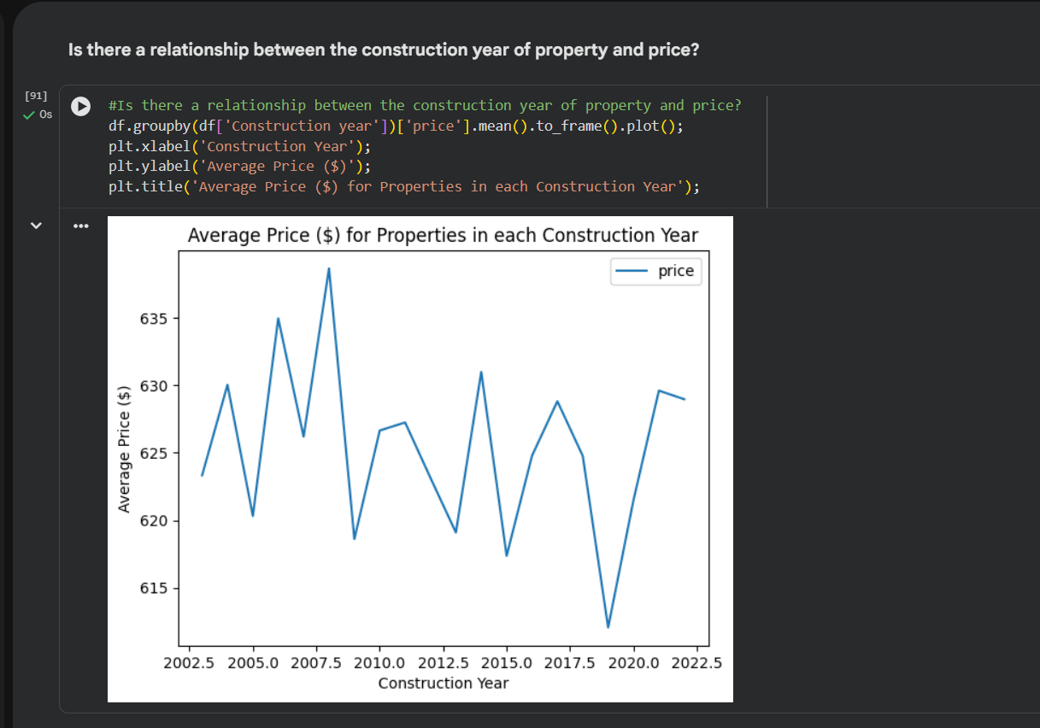
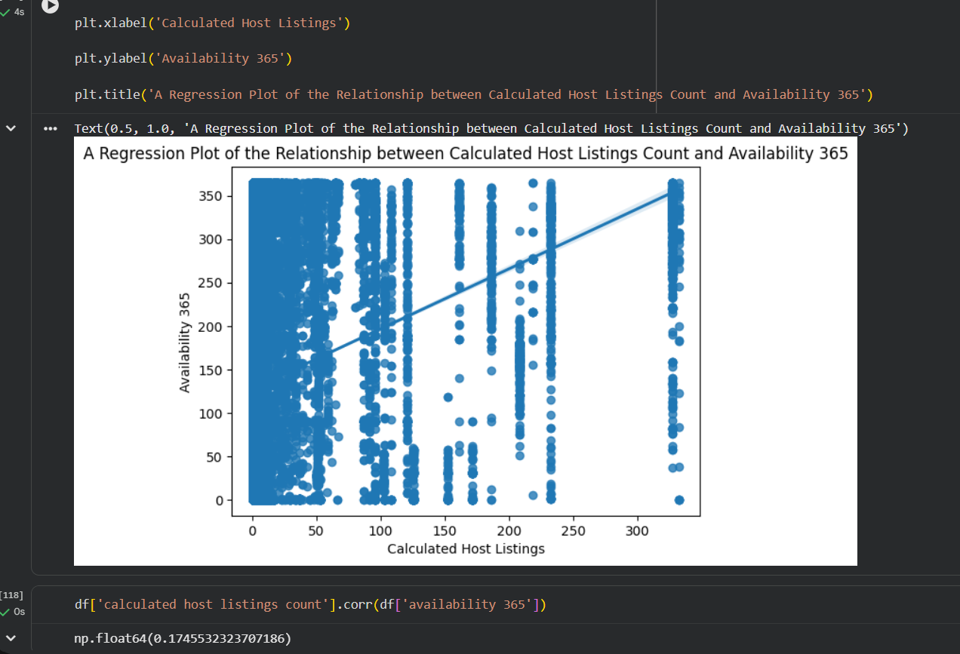
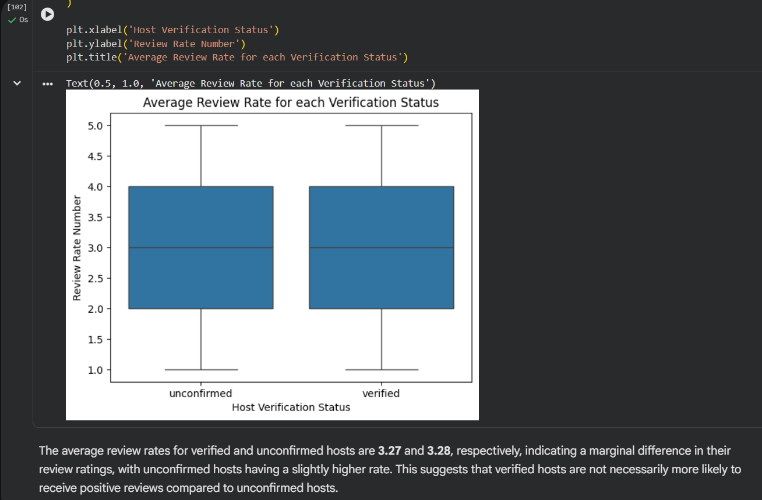
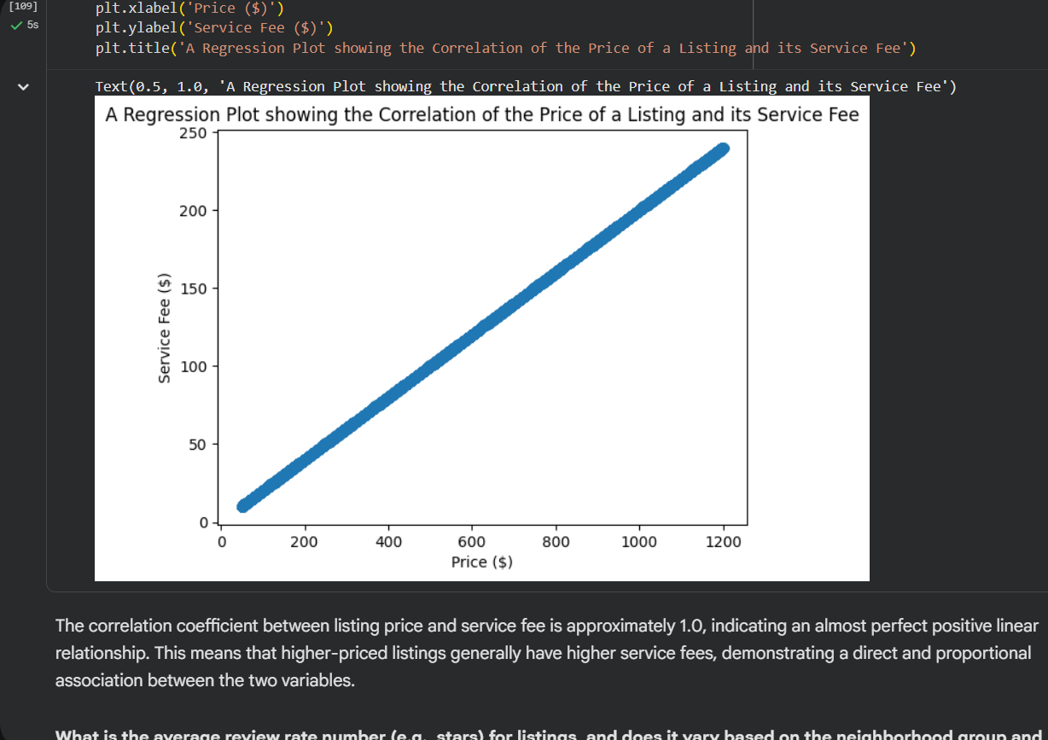
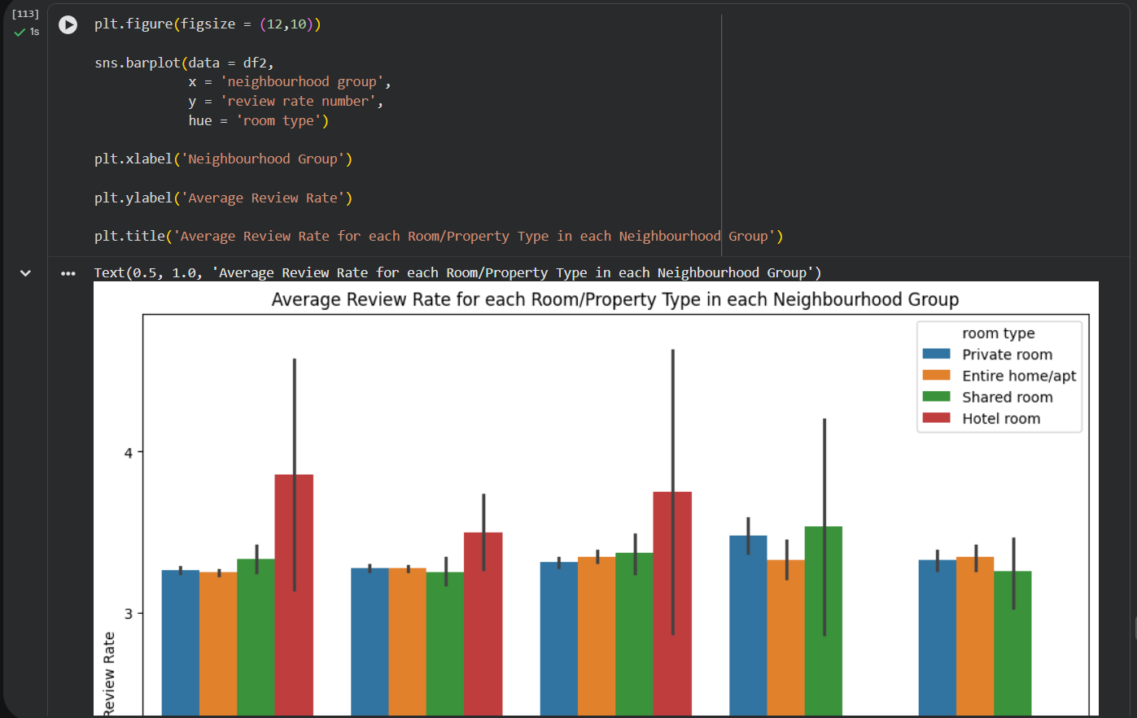
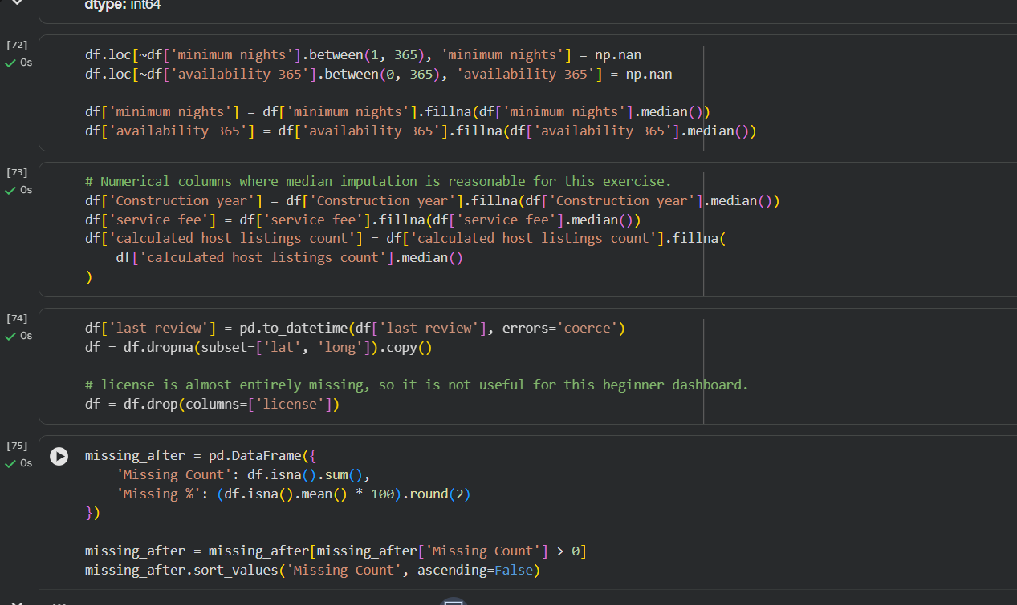
RESULTS
To View Project Notebook

Slide 7
Conclusion
In conclusion, this project has provided a comprehensive analysis of the New York City Airbnb dataset, shedding light on various aspects of the short-term lodging market. Through data wrangling, exploratory data analysis (EDA), and interpretation of summary statistics, we've uncovered valuable insights into listing distribution, pricing dynamics, host, and review analysis.
Key findings include the dominance in counts of Entire home/apt listings, the variability in listing counts across neighbourhood groups, and the downward trend between property construction year and price. Additionally, the analysis highlighted the significance of verified host status on review rates, as well as the strong correlation between listing price and service fee.
Furthermore, conducting sentiment analysis on guest reviews to understand factors driving customer satisfaction and preferences could inform targeted marketing strategies and product improvements for Airbnb. Lastly, expanding the analysis to include predictive modelling techniques, such as regression or machine learning algorithms, could enable forecasting of listing demand, pricing trends, and customer behaviour, facilitating strategic decision-making for stakeholders in the short-term lodging industry.

Slide 8
Thank you
“Turning Data into Insights.”
Questions & Feedback are Welcome
.
.

